Slide 1
Loan Status Prediction Using Exploratory Data Analysis
PRESENTED BY
TEAM:SOLID-4
3RD YEAR-CSE
J.Vamshi Krishna
G.Bharath Chandra
J.Vamshi
P.Rahul

Slide 2
INTRODUCTION
In India, the number of people applying for loans gets increased for various reasons in recent years. The bank employees are not able to analyze or predict whether the customer can pay back the amount or not (good customer or bad customer) for the given interest rate.
Loan approval is a very important process for banking organizations. A bank's profit or loss depends to a large extent on loans i.e., whether the customers are paying back the loan or defaulting. Recovery of loans is a major contributing parameter in the financial statements of a bank. It is very difficult to predict the possibility of payment of loan by the customer.
The aim is to find the nature of the client applying for a personal loan.

Slide 3
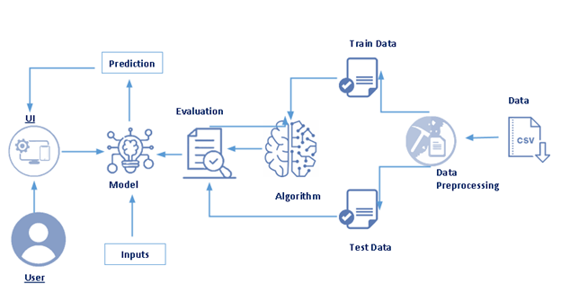
Architecture:

Slide 4
Project flow:
Installing the required packages and libraries.
Importing the required libraries for the model to run.
Downloading the dataset, feeding it to the model, and understanding the dataset
Data Preprocessing – Checking for outliers and null values. If there any null values we use Label Encoding to convert then into binary format.
Dividing the model into Train and Test data. Fitting the model and predicting.
Building Flask Web Application.

Slide 5
Importing The Required Libraries:
In this milestone, we first import the packages required for building the model
Importing Packages:
Pandas- It is a fast, powerful, flexible, and easy to use open-source data analysis and manipulation tool, built on top of the Python programming language.
Numpy- It is an open-source numerical Python library.
Matplotlib- Visualisation with python
sklearn. Preprocessing- This package provides several common utility functions and transformer classes
Seaborn as sns- Seaborn is a data visualization library in Python based on matplotlib

Slide 6
Data Collection:
ML depends heavily on data, without data, it is impossible for a machine to learn. It is the most crucial aspect that makes algorithm training possible. In Machine Learning projects, we need a training data set. It is the actual data set used to train the model for performing various actions.
You can collect datasets from different open sources like kaggle.com, data.gov, UCI machine learning repository etc.

Slide 7
Data Preprocessing:
Data pre-processing is a process of cleaning the raw data i.e. the data is collected in the real world and is converted to a clean data set. In other words, whenever the data is gathered from different sources it is collected in a raw format and this data isn’t feasible for the analysis.
Therefore, certain steps are executed to convert the data into a small clean data set, this part of the process is called as data pre-processing Follow the following steps to process your Data
Import the Libraries
Importing the dataset
Taking care of Missing Data
Label encoding
One Hot Encoding
Feature Scaling
Splitting Data into Train and Test

Slide 8
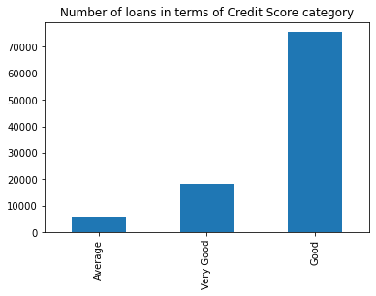
Analyzing The Data:
The graph tells us about the number of loans in Credit Score Category.Here it is distinguished as Average, Very good, and Good as we are sorting it in ascending order according to our DataSet.

Slide 9
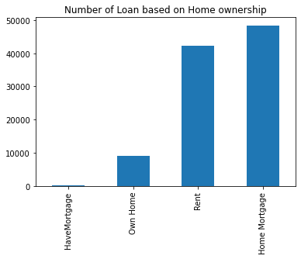
In the graph, we are sorting the elements with values in ascending order. The type of the graph is a bar graph.
The by using a counter function for Home Ownership we can get the count for the four elements Home Mortgage, Own Home, Rent and Have Mortatage According to Our DataSet.

Slide 10
Building Model:
Once the pre-processing of data is done next we apply the train data to the algorithm.There are several Machine learning algorithms to be used depending on the data you are going to process such as images, sound, text, and numerical values. The algorithms that you can choose according to the objective that you might have it may be Classification algorithms are Regression algorithms.
Example:1. Linear Regression.
2. Logistic Regression.
3. Random Forest Regression / Classification.
4. Decision Tree Regression / Classification.
You will need to train the datasets to run smoothly and see an incremental improvement in the prediction rate.
Now we apply the Decision Tree algorithm on our dataset.

Slide 11
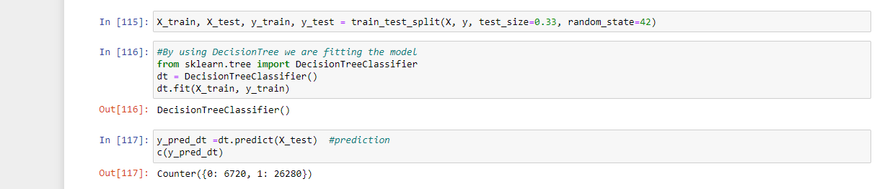
Splitting The Dataset And Predicting:
We split the data into x_train, x_test, y_train, and y_test. The training size data should always be three times more than the testing size data to get accurate results
we use decision tree and fit the model.
The predicted result will be in binary format

Slide 12
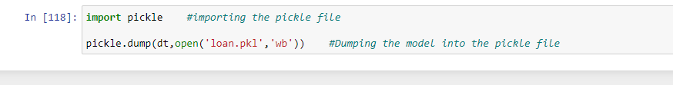
Save The Model:
We import the pickle file and dump the model into it.
Dumping the model into pickle file and saving it

Slide 13
Build Flask Application:
Flask Frame Work with Machine Learning Model In this section, we will be building a web application that is integrated into the model we built. A UI is provided for the uses where he has to enter the values for predictions. The enter values are given to the saved model and prediction is showcased on the UI.
We will be using python for server-side scripting

Slide 14
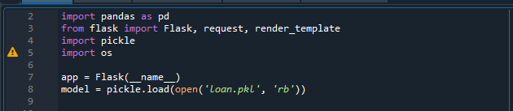
Importing Libraries:
Importing flask module in the project is mandatory. An object of Flask class is WSGI application. Flask constructor takes the name of the current module (__name__) as an argument Pickle library to load the model file.

Slide 15

Routing to the HTML Page:
Here we will be using declared constructor to route to the HTML page
Here we are routing our app to pred() function. This function retrieves all the values from the HTML page using Post request. We are requesting a text from the home .html using the request function. That is stored in an array. This array is passed to the model.predict function (). This function returns the prediction. And this prediction value is rendered to the text that we have mention in the prediction.html page

Slide 16
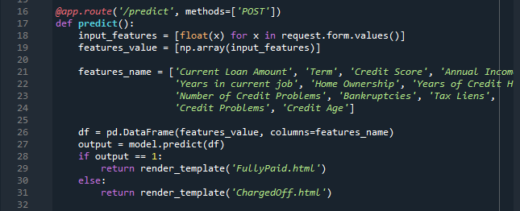

This is used to run the application in local host.

Slide 17
Run The App:
Open anaconda prompt from start menu.
Navigate to the folder where your app.py resides.
Now type “python app.py” command.
It will show the local host where your app is running on http://127.0.0.1.5000/
Copy that localhost URL and open that URL in the browser. It does navigate you to where you can view your web page.
Enter the values, click on the predict button and see the result/prediction on web page.

Slide 18
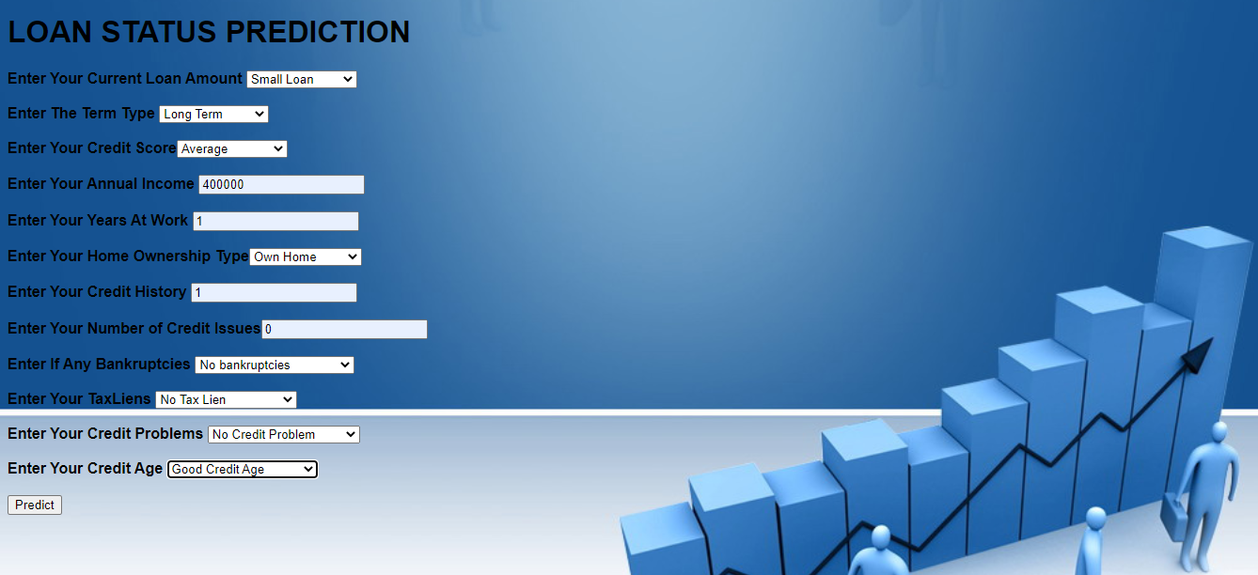
Output:
Here we are routing our app to y_predict() function. This function retrieves all the values from the HTML page using Post request. A variable X test is defined to store the entire element in two-dimensional arrays. This two-dimensional array is passed to model.predictfunction (). This function returns the prediction. And this prediction value is rendered to the text that we mention in the index.html page.

Slide 19
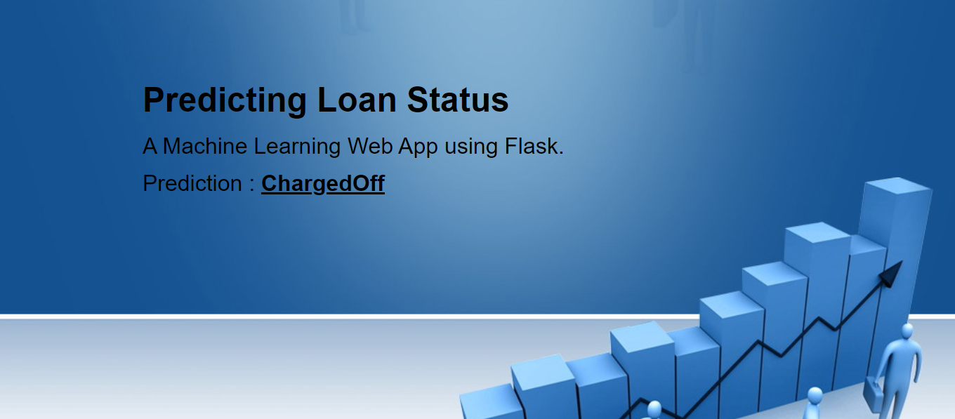
In the previous page after giving all the parameters click on the predict button to get the prediction

Slide 20
Advantages:
1.Easy to read and interpret
2.Easy to prepare
3.Less data cleaning required
DISADVANTAGES:
1.Unstable Nature
2.Less effective in predicting the outcome of a continuous variable

Slide 21
Conclusion:
A system called loan Status prediction system that helps the organization in making right decision to approve or reject the loan request of the customers.
A model is created from a training data. The ML algorithm trained the machine the usage of a fragment of the statistics available and the remaining data is tested. The result of the analysis shows that short term loans are preferred by the majority of the clients and the clients majorly apply loans for debt consolidation. The results are shown in graphs that help the bankers to understand the client’s behavior.

Slide 22
Thank you

